Slide 1

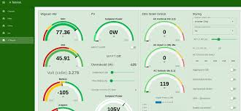
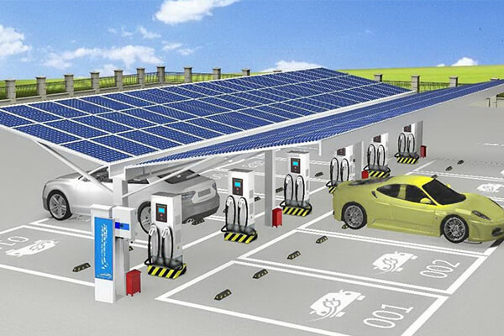
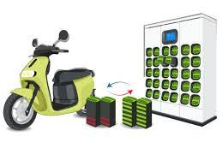
Project Title: Design of IOT Architecture for Battery Charging Management System
Name of the Students: Jagadeeswara Chandra bose.K, M.Tech
Name of the Mentor: Dr. Sujith Kalluri, Ph.D Associate Professor [Dept – ECE]
Project Fund Requested: 30,000 Rs
Duration of the Project : 4 Months

Slide 2
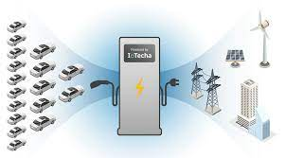
Introduction
Rapid growth of electric vehicles (EVs) increasing demand for efficient charging infrastructure.
Need for sustainable solutions integrating renewable energy sources like solar power and energy storage systems (ESS).
Objective:
  Develop an IoT-based architecture to optimize battery charging management.
  Utilize real-time data monitoring and predictive analytics to enhance efficiency.
Key Benefits:
  Significant reduction in operational costs, achieving up to 88.5% cost efficiency.
  Enhanced battery management through real-time monitoring of critical parameters (voltage, temperature, SOC).
Market Demand:
  Increasing EV sales necessitating more charging stations.
  Consumer preference shifting towards renewable energy-powered solutions.
Future Scope:
  Optimize operations and automate maintenance.
  Expand charging infrastructure to meet growing demand.

Slide 3
Motivation, Research Gap & Problem, Novelty
Research Gap & Problem
Lack of uniform standards for EV charging stations.
Limited Integration of Renewable Energy Sources.
Absence of Comprehensive IoT-Based Charging Management.
No Holistic Approach to Grid Stability.
Minimal Real-Time Monitoring and Control Capabilities.
Motivation
Need of robust and efficient charging infrastructure.
Integrating renewable energy sources and Automation.
To reduce operational costs in charging management.
Innovation with IOT Architecture in battery management technologies.
Novelty
The proposed five-layered architecture uniquely combines IoT technology.
  real-time monitoring in battery charging management.
The PCC with source integration and automation is to optimize energy efficiency.
The simulations indicate a potential reduction of up to 88% in operational costs.

Slide 4
Objectives
Design IoT Architecture for Battery Charging Management
  Remote Monitoring and Control
  Hybrid Energy Source Integration
2.Enhance Grid Stability
  Real-Time Data Processing
  Automated Charging Control
  Minimize Power Grid Disturbances
3. Achieve High Energy Efficiency
  Target: 88% Energy Efficiency
  Optimize Energy Savings
  Seamless Renewable and Non-Renewable Energy Integration

Slide 5

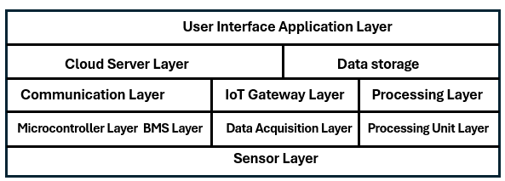
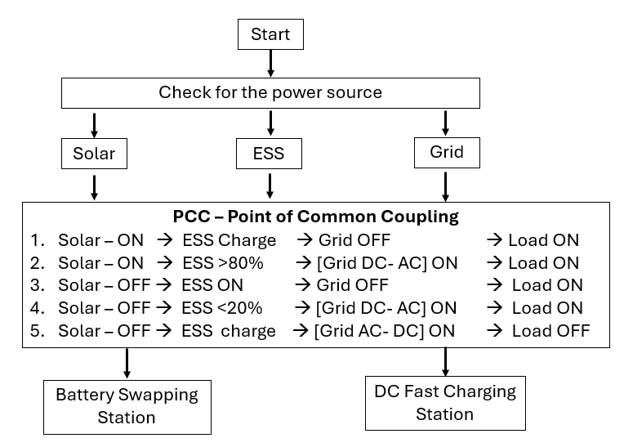

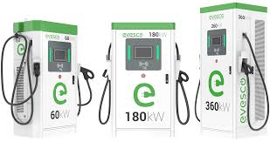

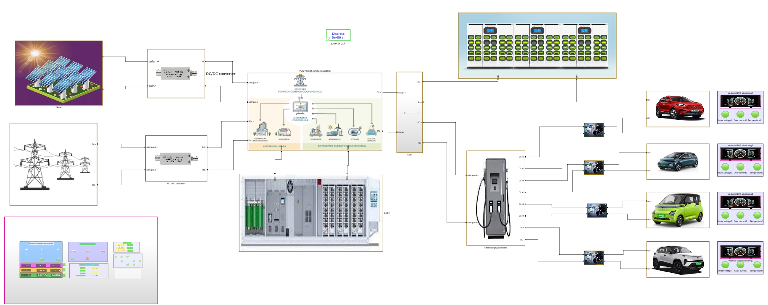
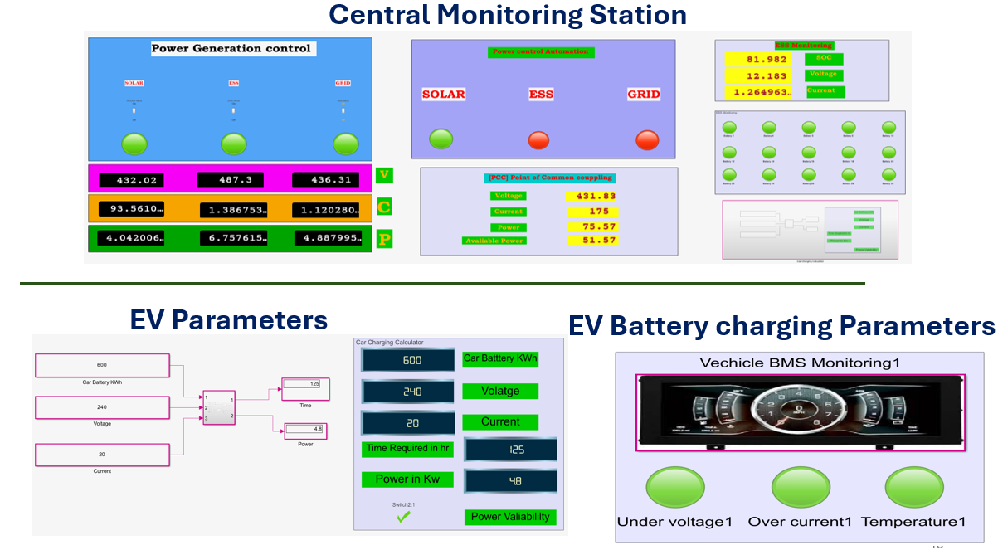

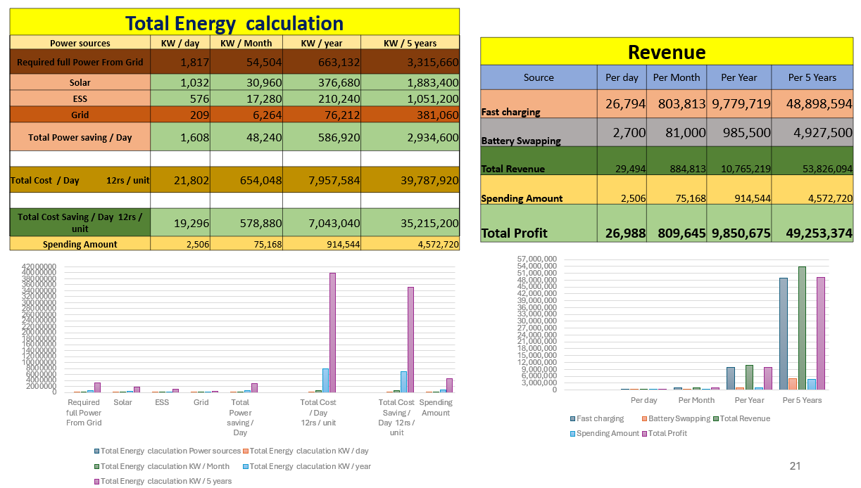
Methodology
1. Design Phase
Integrate Renewable/Non-Renewable Sources
IOT 5 Layered Architecture
Create Stable Charging Infrastructure
Establish Point of Common Coupling (PCC)
Design Battery Swapping & Fast Charging Stations
2. Simulation Phase
MATLAB Simulation
Energy Efficiency Target: 88.5%
Node-RED Data Monitoring
AWS S3 Cloud Storage
QuickSight Data Visualization
Model Simulation
3. Hardware Prototype Phase
Real-Time Fault Detection
IoT Architecture Implementation
Practical Validation of Simulation Results
Advanced Charging Infrastructure Prototype

Slide 6
Estimated – Energy generation required
Power Generation |  |  |  |  |  |  | PCC - Point of common coupling |  |  |  |  | ESS - Charging
Power Source | Voltage [V] | Current [I] | % of Generation/day | Power [P]- KWh | Power/day |  | PCC will Logically be controlled on availability of source |  |  |  |  | No.of batteries | 40
Solar | 430 | 100 | 60 | 43 | 1032 |  | Voltage - [V] | 430 | Output Power/day in KW |  |  | Voltage | 12
ESS | 480 | 50 | 30 | 24 | 576 |  | Current - [I] | 80 |  |  |  | Amper hour - capacity | 100
Grid | 435 | 20 | 10 | 9 | 209 |  | Power - [W] - KW/h | 75 | 1800 | Gen /day |  | Power / charge - Watt / hr | 48000
Total Power Generation per day in KW/24 hr |  |  |  |  | 1817 |  | Power Avaliability | 1.17 | 1772 | use / day |  | Power / one cycle charge - KW | 48
Fast Charging Station Load
Cars | Voltage (V) | Power (kW) | Battery Capacity (kWh) | SOC Avaliable | Required Current |  | Charging Time in hr |  | Unit charge | Cost
1 - Tata Nexon - EV | 400 | 30.2 | 30.2 | 20 | 75.5 |  | 2.47 |  | 10 | 745.83
2- MG ZS EV | 400 | 50 | 44.5 | 30 | 125 |  | 1.49 |  | 10 | 743.75
3-Tata Trigo EV | 400 | 16.8 | 26 | 50 | 42 |  | 4.40 |  | 10 | 739.58
4- Mahindra eVerito | 400 | 70 | 60 | 10 | 175 |  | 1.07 |  | 10 | 747.92
Total Power |  | 167 |  |  | Total Time |  | 9 |  | Total Revenue | 2977
Total Power |  | 1670 | KW power can charge / day |  | Total Time |  | 94 | / 96 hr | Total Revenue | 26794
Battery Swapping Station
Total Batteries | 30
Under maintance | 0
Avaliable batteries | 30
Voltage | 12 |  | Total Batteries charging / day |  |  | 90
Current | 10 |  | Cost of charge per battery |  |  | 30
Time / Battery in hr | 5 |  | Total Amout Per day |  |  | 2700
No of Cycle per day | 3
Power/Battery - KW | 0.12
Total Station KW | 18
Total Energy Required for Full Swapping Station per Day - KW | 54

Slide 7
Estimated – Cost and Energy efficiency - Outcomes
Total Energy calculation
Power sources | KW / day | KW / Month | KW / year | KW / 5 years
Required full Power From Grid | 1,817 | 54,504 | 663,132 | 3,315,660
Solar | 1,032 | 30,960 | 376,680 | 1,883,400
ESS | 576 | 17,280 | 210,240 | 1,051,200
Grid | 209 | 6,264 | 76,212 | 381,060
Total Power saving / Day | 1,608 | 48,240 | 586,920 | 2,934,600
Total Cost / Day 12rs / unit | 21,802 | 654,048 | 7,957,584 | 39,787,920
Total Cost Saving / Day 12rs / unit | 19,296 | 578,880 | 7,043,040 | 35,215,200
Spending Amount | 2,506 | 75,168 | 914,544 | 4,572,720
Revenue
Source | Per day | Per Month | Per Year | Per 5 Years
Fast charging | 26,794 | 803,813 | 9,779,719 | 48,898,594
Battery Swapping | 2,700 | 81,000 | 985,500 | 4,927,500
Total Revenue | 29,494 | 884,813 | 10,765,219 | 53,826,094
Spending Amount | 2,506 | 75,168 | 914,544 | 4,572,720
Total Profit | 26,988 | 809,645 | 9,850,675 | 49,253,374

Slide 8
Expected Research Outcome
1
2
Research Documentation
3
Design Patent
IoT-Enabled EV Charging Prototype
Functional Battery Charging Management System
Integration with Cloud Infrastructure
Real-Time Monitoring Capabilities
Complete System Architecture Documentation
Performance Analysis Reports
Implementation Guidelines
Novel IoT Architecture for Battery Charging
Integration Method of Renewable/Non-Renewable Sources
Smart Load Management System

Slide 9
Budget Details Requested – with Justification
Project bill of materials
S.no | Components | Items cost
1 | Solar Pannel + Solar charger converter | 4500
2 | Lead Acid Rechargble Batteries | 2600
3 | Power Converters | 3500
4 | Lithium-Ion Batteries + Measurement kit | 5400
5 | sensors + Switches | 5600
6 | IOT Microcontrollers | 3840
7 | Raspberry Pi Kit | 4000
8 | Tool Kit + Statinonary | 1000
Total |  | 30440
Patents with SRM AP Affiliations
Patent Filled at Indian Patent office [05.02.2025] – Application no – 202541009491
Hardware Prototype

